Slide 1

Transforming the West Midlands by delivering the best Integrated Transport System for the future

Slide 2


You can be anything you want to be

Slide 3

“Informed Choice”
Sixth Form
  A-Levels
  T-Levels
  BTECs
Further Education College
  Apprenticeship
  A-Levels
  T-Levels
  BTECs
Independent Training Provider
  Apprenticeship
  Vocational education & training
Higher Education (University)
  Degree
Research, Research, Research
Discuss with teachers, parents, carers, friends, family, peers….
Your career path can go straight, sideways, crossroads, winding…. it doesn’t matter as long as you learn from each experience

Slide 4

T-Levels option after GCSEs
Agriculture, land management and production
Animal care and management
Accounting
Building services engineering for construction
Craft and design
Design and development for engineering and manufacturing
Design, surveying and planning for construction
Digital data analytics
Digital software development
Digital support and security
Education and early years
Engineering, manufacturing, processing and control
Finance
Health and science
Legal Services
Maintenance, installation and repair for engineering and manufacturing
Management and administration
Marketing
Media, broadcast and production
Science
T Level subjects | T Levels

Slide 5
Apprenticeships
Starting an apprenticeship
To start an apprenticeship, you’ll need to:
be 16 or over
live in England
not be in full-time education
You can apply for an apprenticeship while you’re still at school.
What you'll do as an apprentice
An apprenticeship is a job where you’ll:
  earn a wage and get holiday pay
  work alongside experienced staff
  gain job-specific skills
  get time for training and study related to your role
The training might be at your place of work, a college, a training provider or online.
Over 650 apprenticeships!!
Apprenticeship search / Skills England

Slide 6
Levels
Apprenticeships
Name | Level | Equivalent educational level
Intermediate | 2 | GCSE
Advanced | 3 | A level
Higher | 4,5,6 and 7 | Foundation degree and above
Degree | 6 and 7 | Bachelor’s or master’s degree
Four levels: usually lasting up to 4+ years depending on the starting point
Some apprenticeships may also give you an additional qualification, such as a diploma.
Check out Skills England website
Apprenticeship search / Skills England

Slide 7
Apprenticeship Rates
 | 21 and over National Living Wage (NLW) | 18 to 20 | Under 18 | Apprentice
April 2024 (old rate) | £11.44 | £8.60 | £6.40 | £6.40
April 2025 (current rate) | £12.21 | £10.00 | £7.55 | £7.55

Slide 8

What Apprenticeships are there?
Apprenticeship search / Skills England

Slide 9
Application process - example
On line application form
CV & covering email / letter
Telephone interview
Invitation to Assessment Day (virtual or in person)
Face to Face interview (virtual or in person)
Second interview (possibly panel)
Outcome

Slide 10
Skills employers look for
Communication
Positive attitude/enthusiasm
Teamwork
Problem solving
Being organised
Reliable & Punctual
Self Belief/ Confidence
Resilience
Determination
Focus
Safety conscious
Attention to detail
IT literate
Able to use initiative
Creativity
Empathy towards others
Caring and kind

Slide 11
Useful career websites

Slide 12

Assessment Days for apprenticeships…
Aptitude Test, FREE Online Practice Aptitude Tests
What is an Apprenticeship Assessment Centre? (youthemployment.org.uk)
Apprenticeship Assessment Centres | RateMyApprenticeship Blog
Apprenticeship Psychometric Tests | Higherin

Slide 13
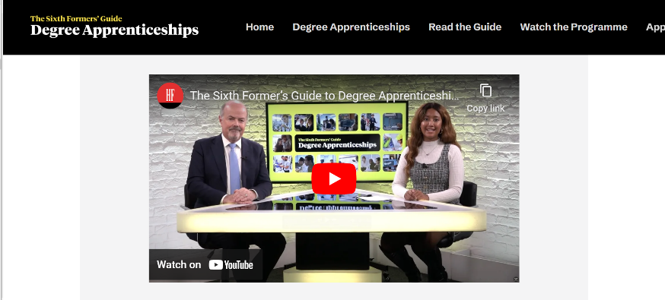
Sixth Form Guide to Degree Apprenticeships
https://youtu.be/QN7GWVwuJB8

Slide 14

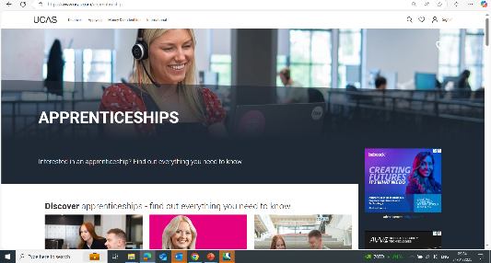
UCAS - resources
UCAS | At the heart of connecting people to higher education

Slide 15
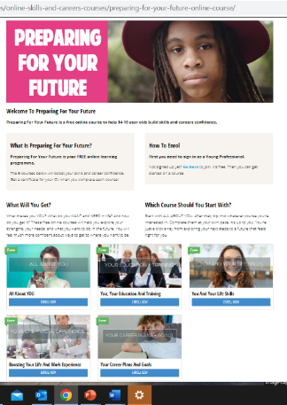

Youth Employment UK - resources
https://www.youthemployment.org.uk/young-professional-training/

Slide 16
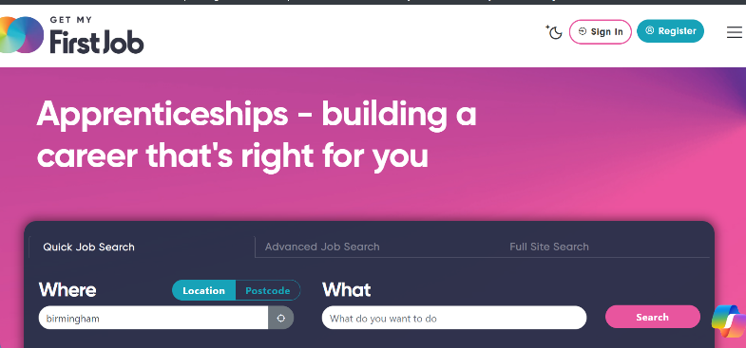
Get My First Job
  Resources include:
  Apprenticeships
  Skills Bootcamps
  Career Quiz
GetMyFirstJob | Apprenticeships, Degree Apprenticeships, Work Experience & Graduate Jobs

Slide 17
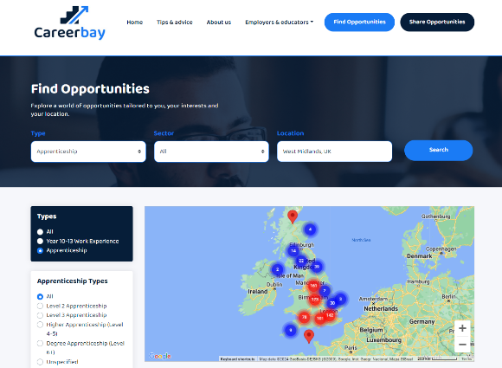

Careerbay - resources
www.careerbay.co.uk

Slide 18

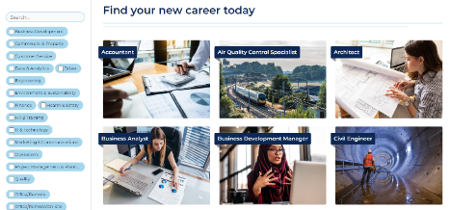
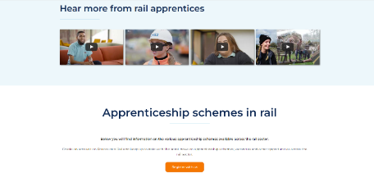
Routes into Rail - resources
https://routesintorail.org/

Slide 19



Business Apprenticeships - examples
Business administrator L3
HR Support L3
Recruitment Resourcer L2
Team Leader or Supervisor L3
Associate Project Manager L4
Operations or Departmental Manager L5
Leisure Duty Manager L3
School Business Professional L4
Quality Practitioner L4
Career Development Professional L6
Information Communications Technician L3
Data Analyst L4

Slide 20
Useful Infrastructure (Rail & Construction) Websites
http://careers.laingorourke.com/
https://www.balfourbeatty.com/careers/job-search/
https://www.networkrail.co.uk/career-search/
https://www.railwaypeople.com/Rail-Jobs
https://www.siemens.com/uk/en/home/company/jobs/search-careers.html
https://careers.westmidlandsmetro.com/jobs
https://www.bamnuttall.co.uk/careers/
https://www.costain.com/careers
https://careers.kier.co.uk/jobs/vacancy/find/results/
https://jobsearch.alstom.com/
https://construction.morgansindall.com/careers-0
https://www.lendlease.com/uk/careers/
https://www.goconstruct.org/
https://www.notgoingtouni.co.uk/
https://careers.laingorourke.com/
https://careers.nationalhighways.co.uk/
http://metroalliance.co.uk/careers/
Careers with HS2 Ltd - HS2
https://www.hs2.org.uk/jobs-and-skills/careers-with-our-supply-chain/jobs?s=&job_location%5B%5D=West+Midlands&category%5B%5D=&search=1
https://careers.bouygues-construction.co.uk/bouygues-uk-search?search=&location=All
http://tonygee.com/careers/
http://www.pellfrischmann.com/career-opportunities
Careers – Barhale
http://www.rssinfrastructure.com/careers-2/
https://www.westmidlandsrailway.co.uk/about-us/careers
https://www.avantiwestcoast.co.uk/about-us/careers
Careers | Join the team | Colas Rail UK
Home | Colas Rail UK
Job Search | DB Group
Job Results | Atkins | AtkinsRéalis Careers (atkinsrealis.com)

Slide 21
Useful Career Websites for rail & construction
Civil engineer | Explore careers | National Careers Service
Civil engineering technician | Explore careers | National Careers Service
Quantity surveyor | Explore careers | National Careers Service
Apprenticeships, Graduate Schemes & Jobs | Careermap
How to start thinking about your career – icould
Construction: Building the future - Careermap
Advice for over 18s | Institution of Civil Engineers
The Sixth Formers' Guide to Degree Apprenticeships 2025
updates:
https://news.railbusinessdaily.com/
https://www.careersinconstruction.com/companies
https://www.gov.uk/guidance/civil-service-online-tests (useful online tests)

Slide 22

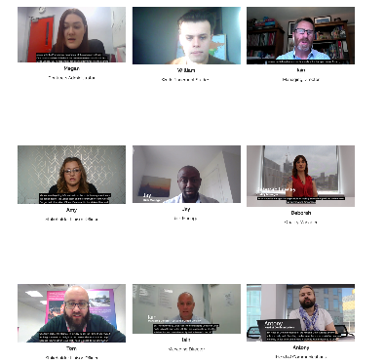
Connecting Futures – Careers on Track
Connecting Futures: Careers on Track is the online skills and careers hub from the Midland Metro Alliance.
On this webpage, you’ll find members of staff, both past and present, from the Midland Metro Alliance, who share their experiences in getting into their chosen profession and tell you what it is like working in the construction industry
Currently 50 videos online from apprentices & WEX to Director level
Dante video Apprenticeship Wednesday with Dante on Vimeo
Taylor Video Taylor talks T-Levels on Vimeo
https://metroalliance.co.uk/connecting-futures/

